Slide 1
Presentation on Snake Ladder Game
Presented By
[Sheikh Muhammad Samir Hoda] [THA081BCT036]
[Shishir Shrestha] [THA081BCT038]
[Prasiddha Adhikari] [THA081BCT021]
[Shivam kumar sah] [THA081BCT039]

Slide 2
Submitted to:
Department of Electronics and Computer Engineering
Thapathali Campus
Kathmandu, Nepal
12th March 2025

Slide 3
Introduction
Game
A game is an interactive activity with rules, goals and challenges designed for entertainment, learning, or competition.
Snake ladder Game
Snake and Ladder is a classic board game where players move their tokens based on dice rolls, climbing ladders to advance and sliding down snakes when landed upon, with the goal of reaching the final square first.
The game is based on luck, with the goal of reaching the final square first.

Slide 4
History
The game of Snake and Ladder traces its origins to ancient India, where it was known as Moksha Patam or Gyan Chaupar. Created as a moral and educational tool, it was designed to teach players about karma, virtues, and vices, with ladders representing good deeds leading to salvation (moksha) and snakes symbolizing sins leading to rebirth (samsara). The game was later introduced to Britain by colonial rulers in the 19th century and modified into the modern version known today. It spread globally, with variations appearing in different cultures, eventually becoming a popular board game for children and families worldwide.

Slide 5
Objectives
. Reach 100 while avoiding snakes and using ladders.
Implementing the game logic in C.
Using color in C program.
Generate Random numbers

Slide 6
Features of the Game
Multiplayer support (2 or more players)
Random dice rolls for fairness
Ladders to boost progress
Snakes to challenge players
Unlocking dice mechanism
When one player reach to 100 then remaining can continue play.

Slide 7
How the Game Works?
Players enter their names and number of participants.
Each player rolls the dice (random number from 1-6).
Players move forward based on the dice roll.
Position of player denote by P1, P2,P3……
Different colour are used for denote the position different position of player.

Slide 8
How the Game Works?
If multiple player at the same posiiton then denote by #number of player#.
Ladders help players climb up.
Snakes push players down.
The first player to reach 100 wins

Slide 9
Code Structure
Main Components(functions used):
disc() → Rolls a random dice value
scoreboard() → Displays the game board in the console
main() → Handles game flow, input, and movement logic

Slide 10
Code Structure
<stdio.h> → Standard I/O functions
<stdlib.h> → Random number generation
<time.h> → Seeding for randomness
<windows.h> → Console text color formatting
<conio.h> ->console input output

Slide 11
Code Structure
Before move in code you have to read it
p[20]>players position in scoreboard function
n>no. of players
b[20]>condition for not printing you have unlocked your dies again and again
z[20]>condition for not printing you have not unlocked your dies again and again
l>condition for not aking no. of players again and again
c[20][20]>name of the players
a[20]>position of the players in main function
count>condition to stop the game if n-1 players reaches 100
flow of code is : main>disc>scoreboard>main

Slide 12
Code
Header file
#include <stdio.h>
#include <conio.h>
#include <stdlib.h>
#include <time.h>
#include <windows.h>

Slide 13
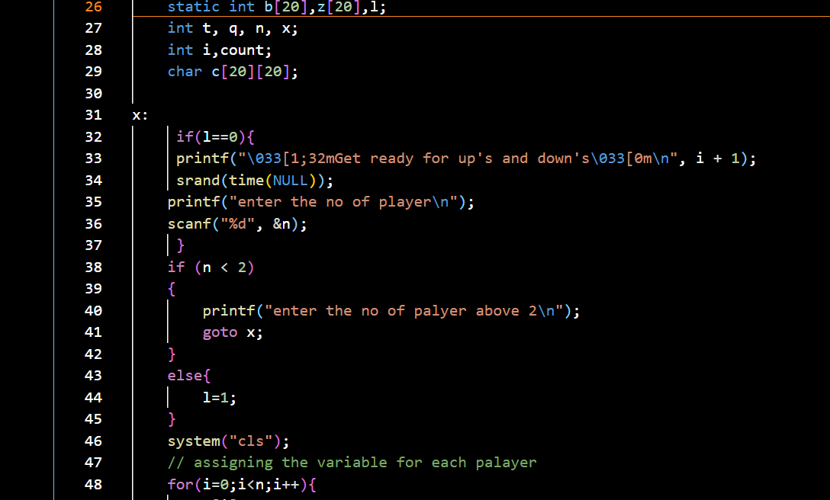
Code
Main Function

Slide 14
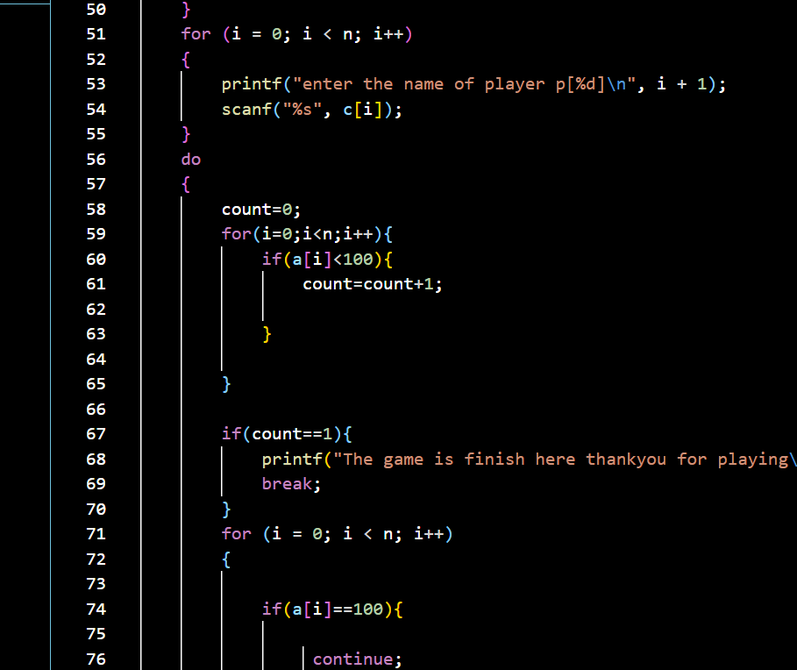
Code

Slide 15
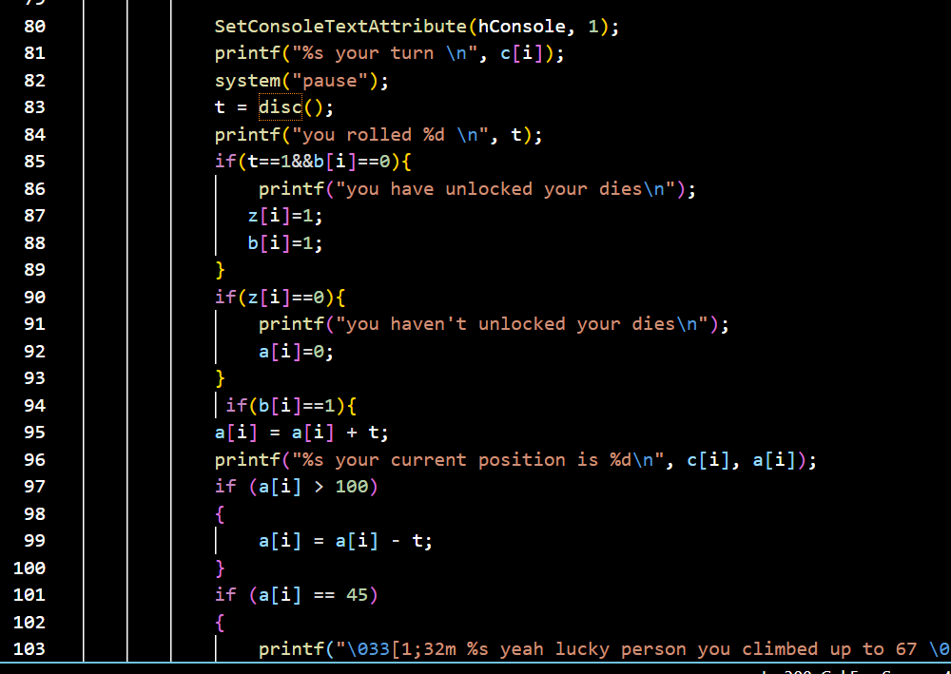
Code

Slide 16
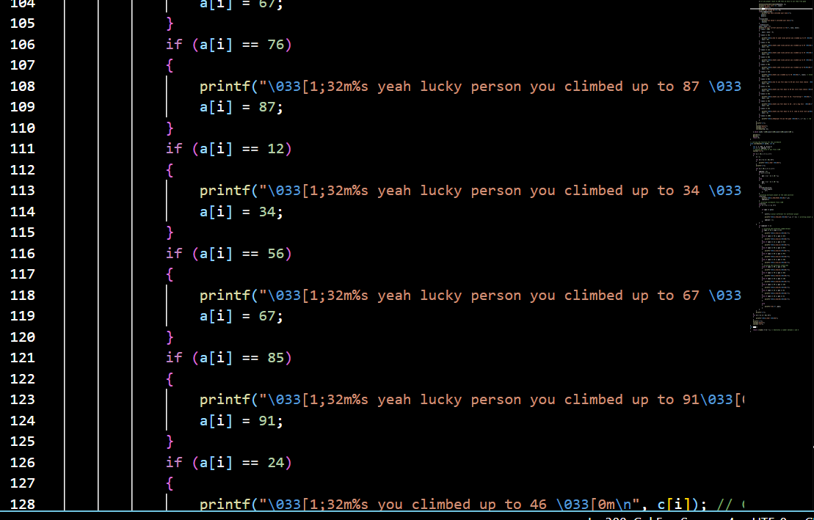
Code

Slide 17
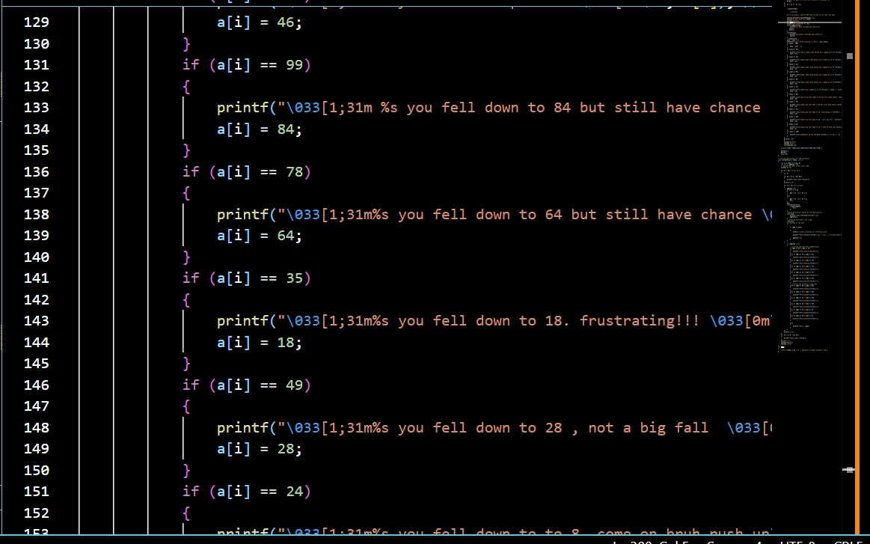
Code

Slide 18
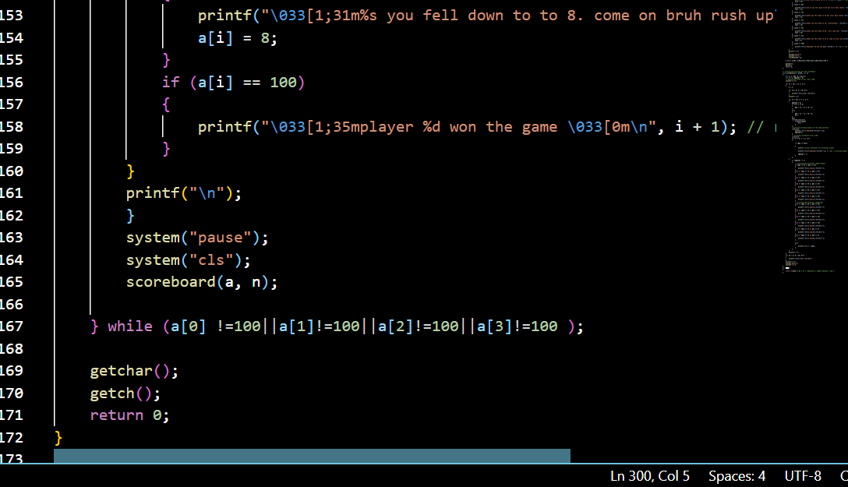
Code

Slide 19
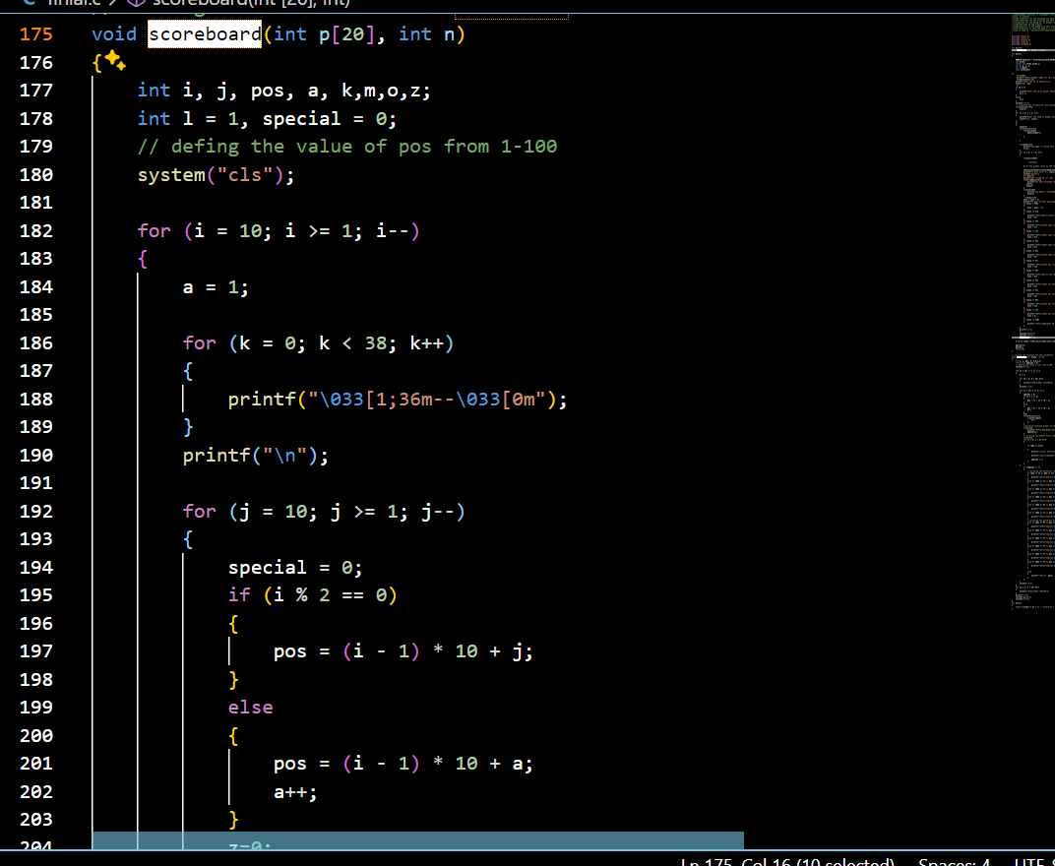
Code
Scoreboard Function

Slide 20
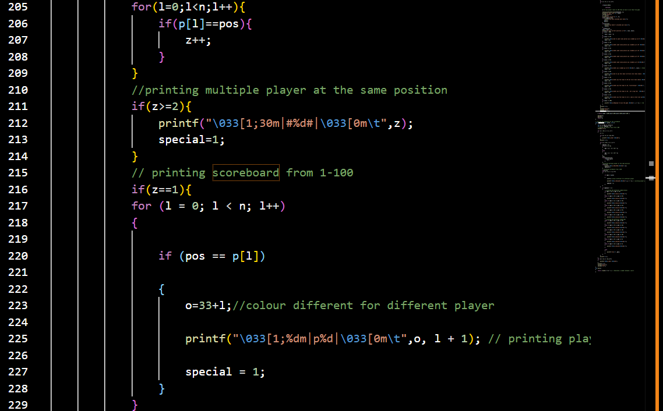
Code

Slide 21
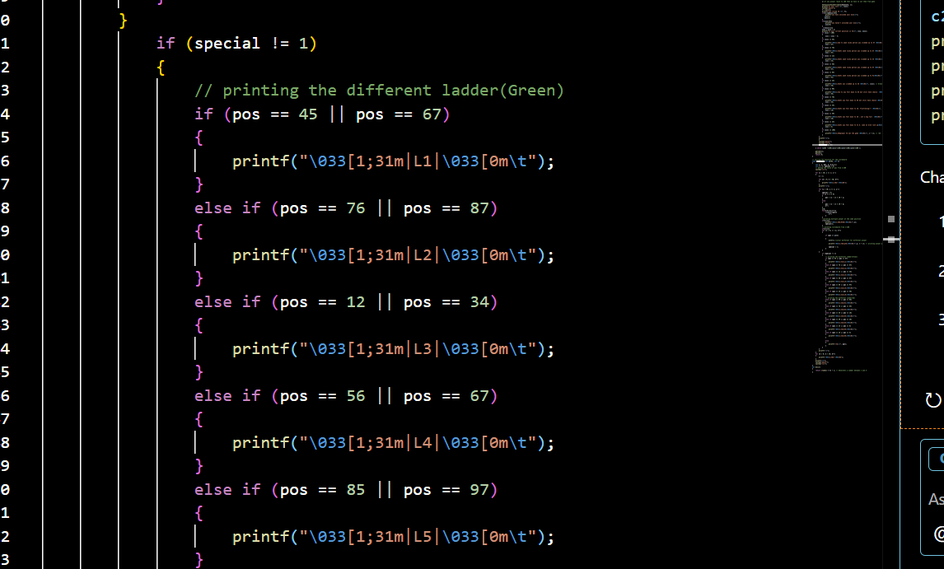
Code

Slide 22

Code

Slide 23
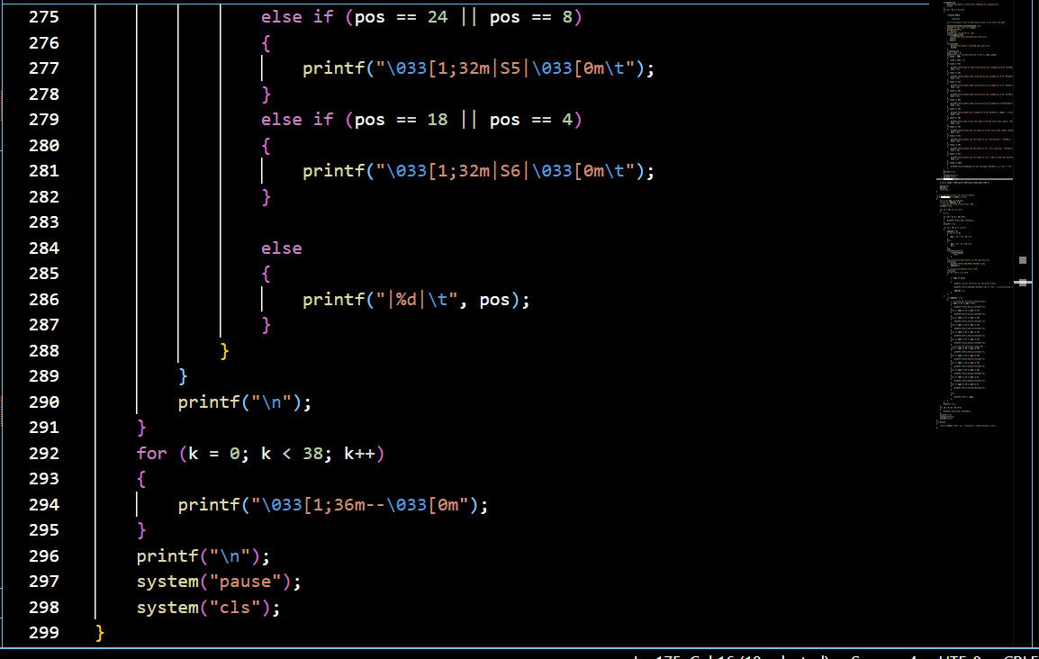
Code

Slide 24
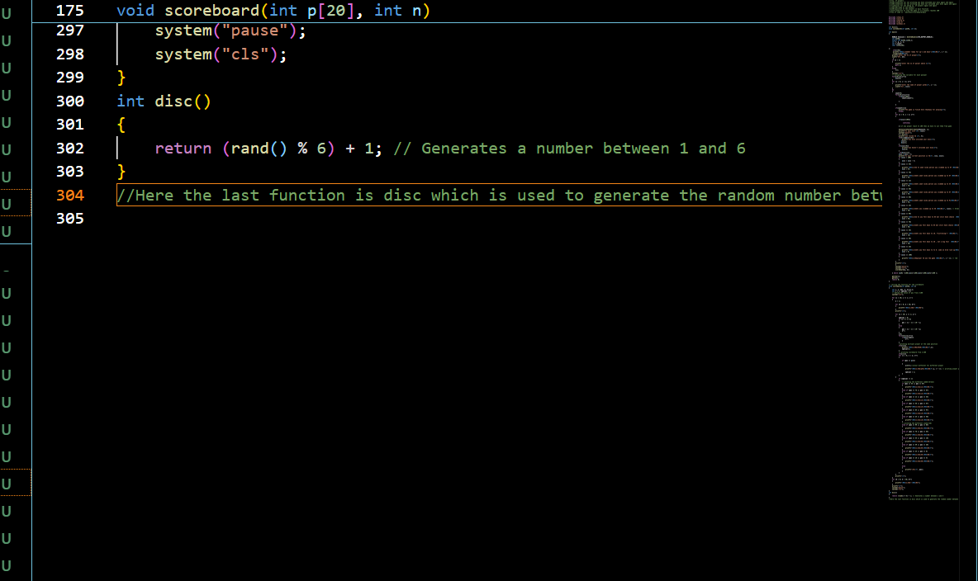
Code
Disc Function

Slide 25
Special Rules
Players must roll a 1 to unlock their dice.
If a player exceeds 100, their move is canceled.
Special positions for snakes 🐍 and ladders 🪜 affect movement:
Ladder | Moves up to
12 | 34
24 | 46
45 | 67
56 | 68
76 | 87
85 | 91

Slide 26
Special Rules
Snake | Moves Down to
99 | 84
78 | 64
35 | 18
49 | 28
24 | 8

Slide 27
Game Board Representation
Uses a 2D representation with numbered squares.
Special positions for snakes & ladders.
Players' positions stored in an array.
Each player is represented with a unique color code.
Snakes (S) and Ladders (L) are marked for visibility.
Two different color for snake and ladder.
Specify the ending and starting point of sanke and ladder.

Slide 28
Winning Condition
A player wins when they land exactly on 100.
If a dice roll exceeds 100, they remain in the same position.
The game announces the winner and ends.

Slide 29
Challenges Faced
Handling player turns efficiently
Ensuring no moves exceed 100
Preventing infinite loops in the game logic

Slide 30
Improvements & Future Scope
Add graphical interface (GUI)
Implement network multiplayer mode
Save and load game progress

Slide 31
Conclusion
A simple yet engaging game built in C.
Showcases loops, conditions, and functions effectively.
A great way to learn game logic implementation!
Future enhancements could include a GUI version!

Slide 32
Thank You!!!!
ANY QUESTIONS????

